Slide 1
ANALYSIS OF PALMER ARCHIPELAGO PENGUINS
Team HAT: Howard Mach, Andy Chandler, Thompson Pham

Slide 2
DATA SET INFORMATION
SIZE | 344 observations with 17 variables, totaling 5,848 data points, detailing penguins in the Antarctic Peninsula
SOURCE | Samples from the Palmer Station, as a part of the Long Term Ecological Research Network in Antarctica working to analyze the penguins of 3 different islands on or near the Palmer Archipelago
RESPONSE VARIABLE | Flipper Length (mm)
PREDICTOR VARIABLES | Clutch Completion, Culmen Length (mm), Culmen Depth (mm), Body Mass (g), Delta 15 N (o/oo), Delta 13 C (o/oo), Sex, Species, Island, Date Egg
ANALYSIS GOAL | Our goal was predict the flipper length of each given penguin based on their varying characteristics
Data set viewing locations: KAGGLE | GITHUB
Environmental Data Initiative: CHINSTRAP | GENTOO | ADÉLIE

Slide 3
01
DATA SET CLEANING & EXPLORATORY ANALYSIS

Slide 4
DATA CLEANING
Removed Rows w/ NA
19 Rows
17 Variables, of which we removed 5
Study name
Sample number
Individual ID
Region
Comments

Slide 5
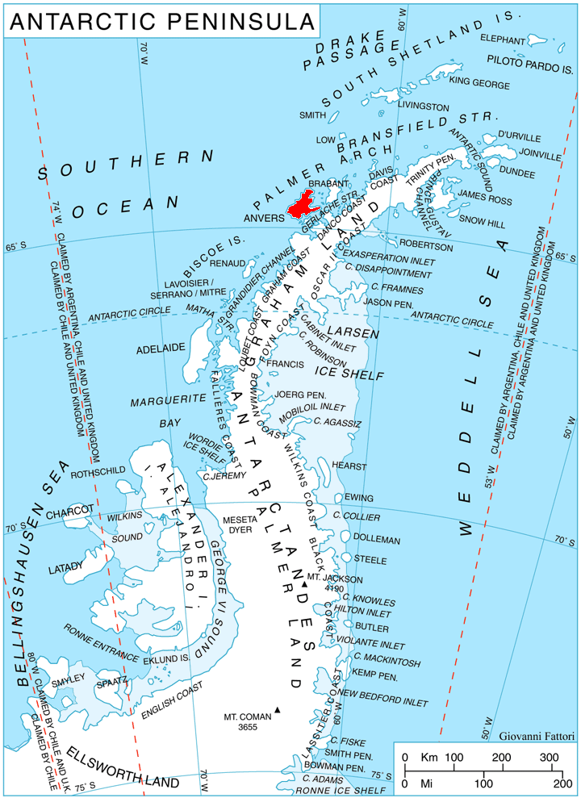
THE PALMER STATION
~125.32 miles North of the Antarctic Circle 64°46′27″S 64°03′10″W

Slide 6
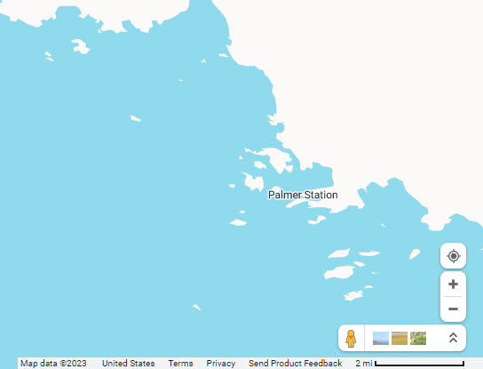
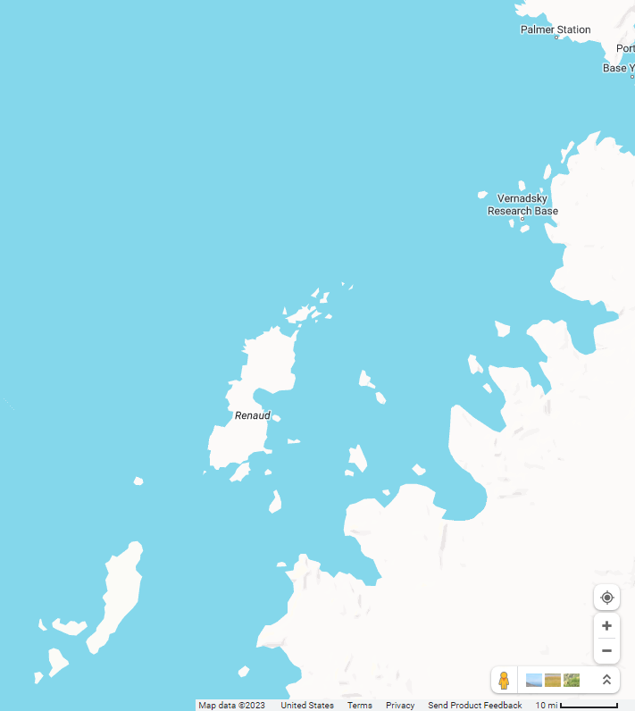
Dream Island
Torgersen Island
Biscoe Islands
~6.86 miles from Palmer Station 64°44′S 64°14′W
~1.27 miles from Palmer Station: 64°46′S 64°5′W
~118.74 miles from Palmer Station 65°26′S 65°30′W

Slide 7
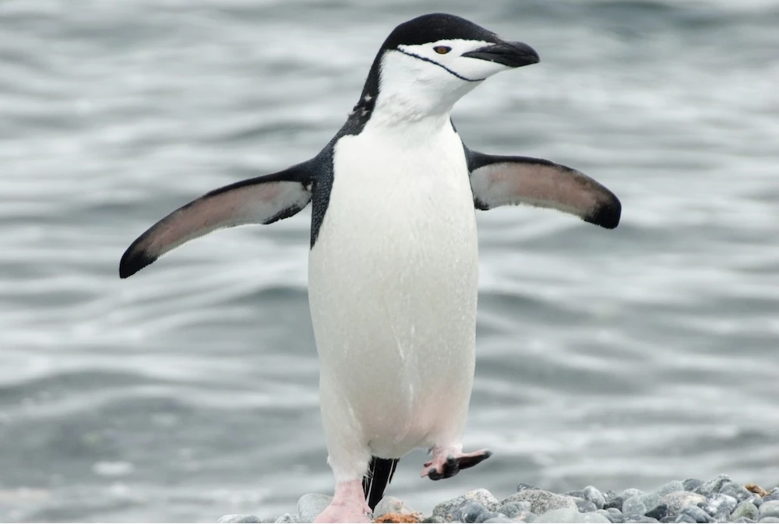
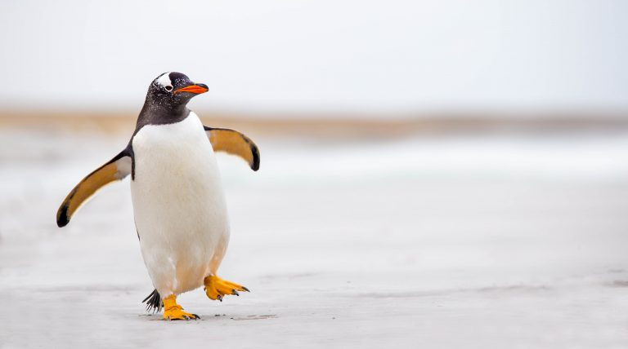
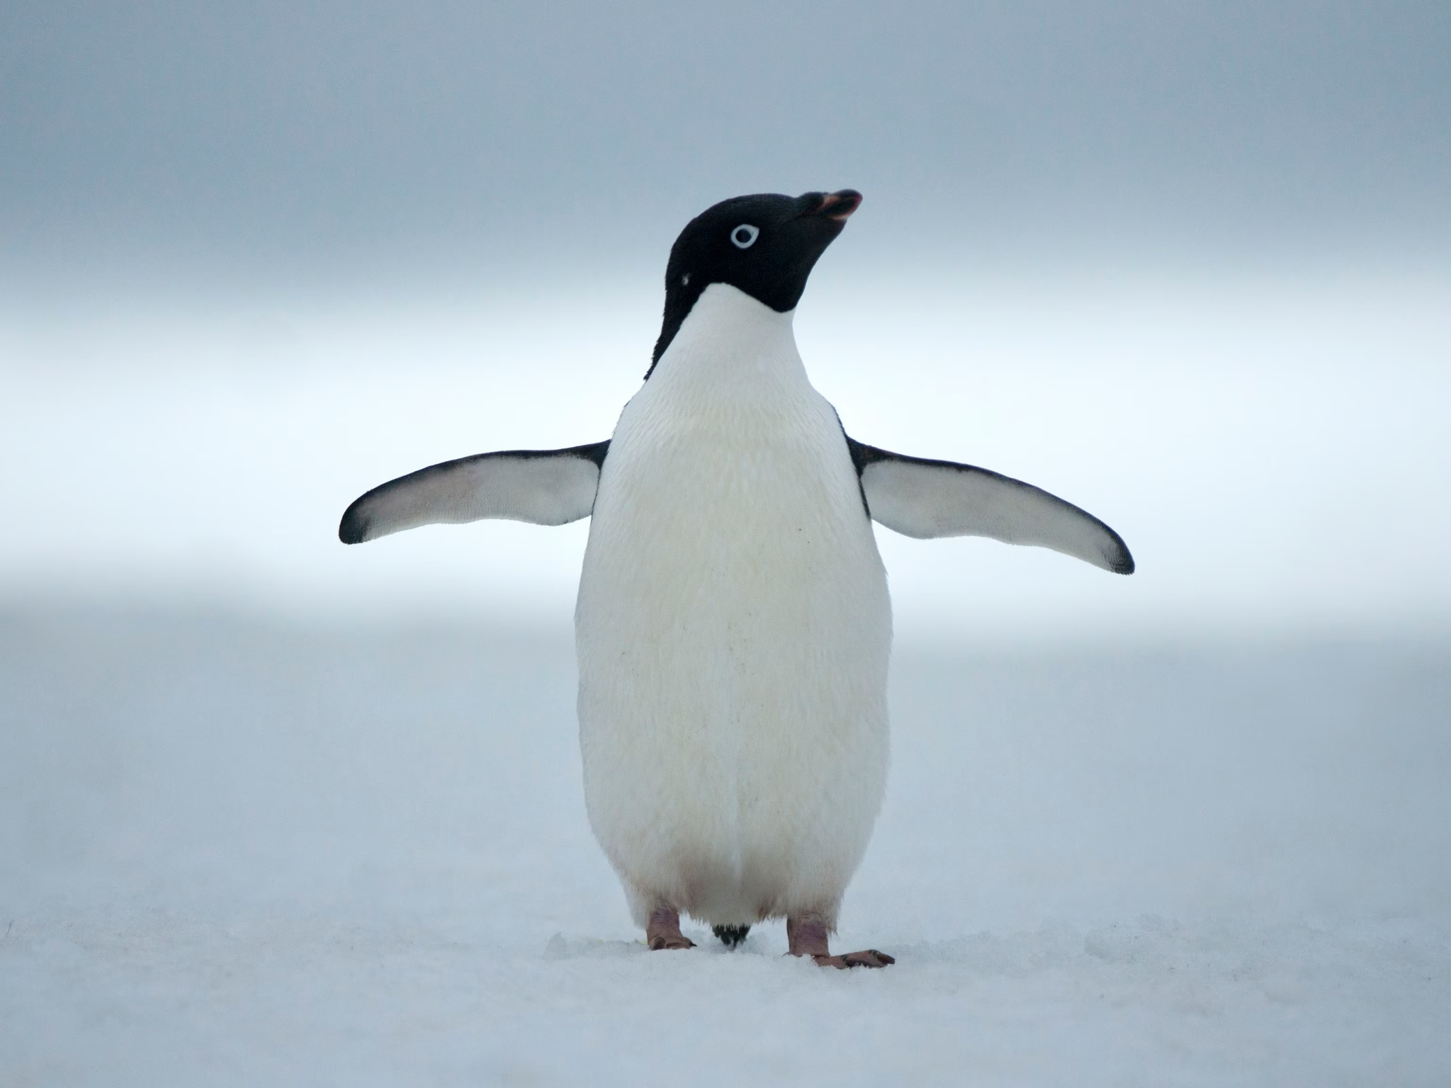
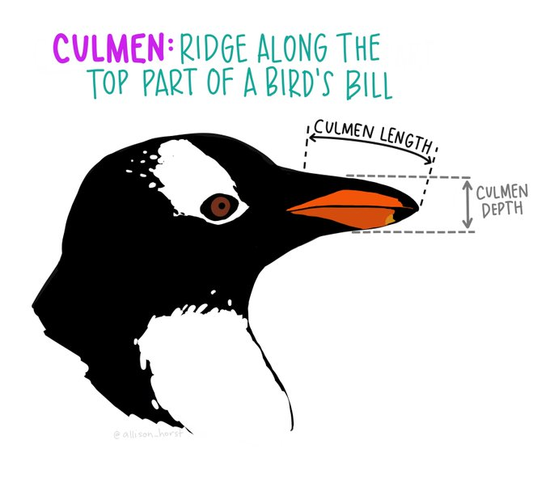
PENGUIN SPECIES
ChinStrap
Gentoo
Adélie

Slide 8
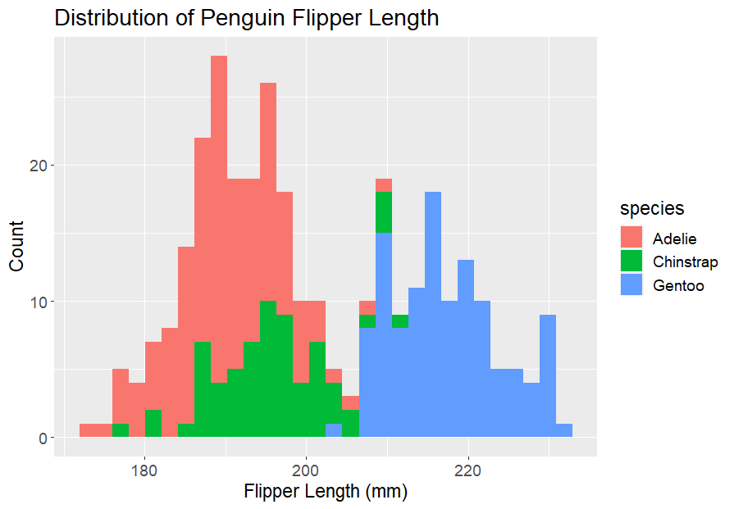
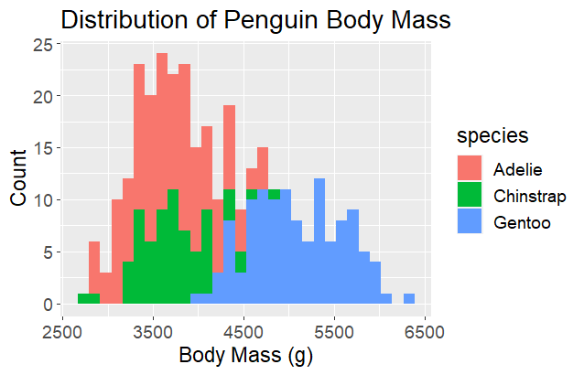
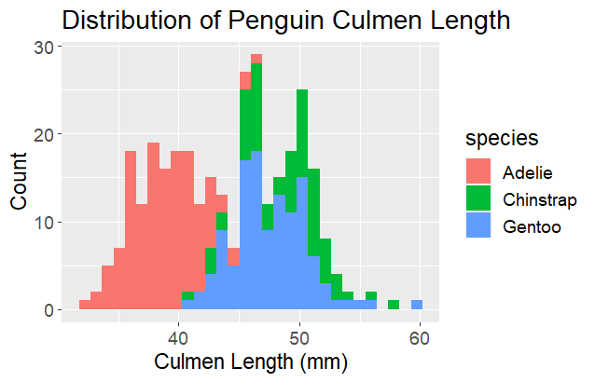
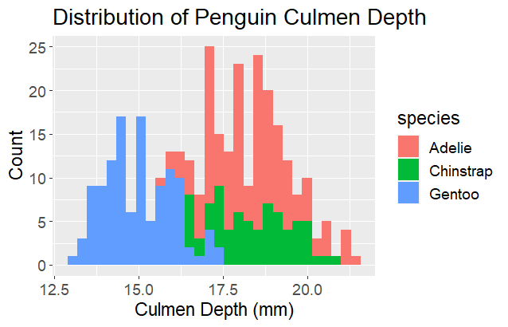
EXPLORATORY DATA ANALYSIS
Bimodal Distribution
Two distinct groups
Potential Correlation
Adelie & Chinstrap
species flipper_length_mm
Adelie 172 - 210
Chinstrap 178 - 212
Gentoo 203 - 231

Slide 9
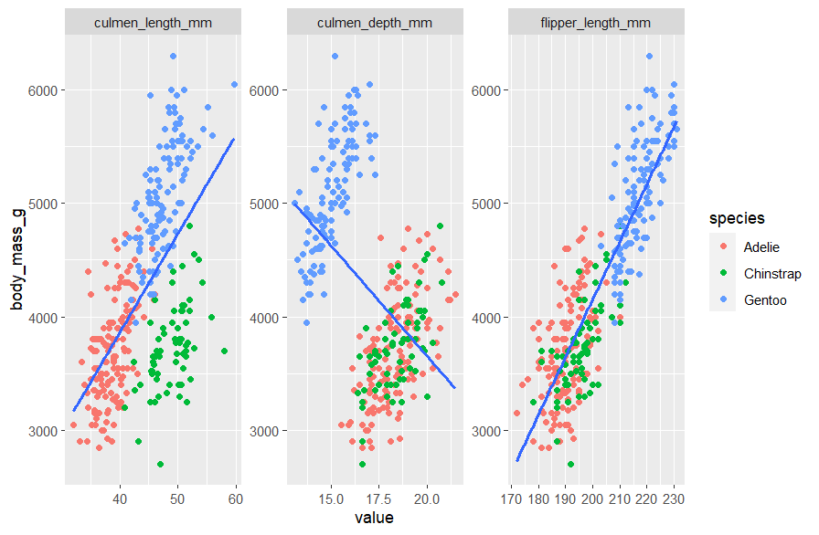
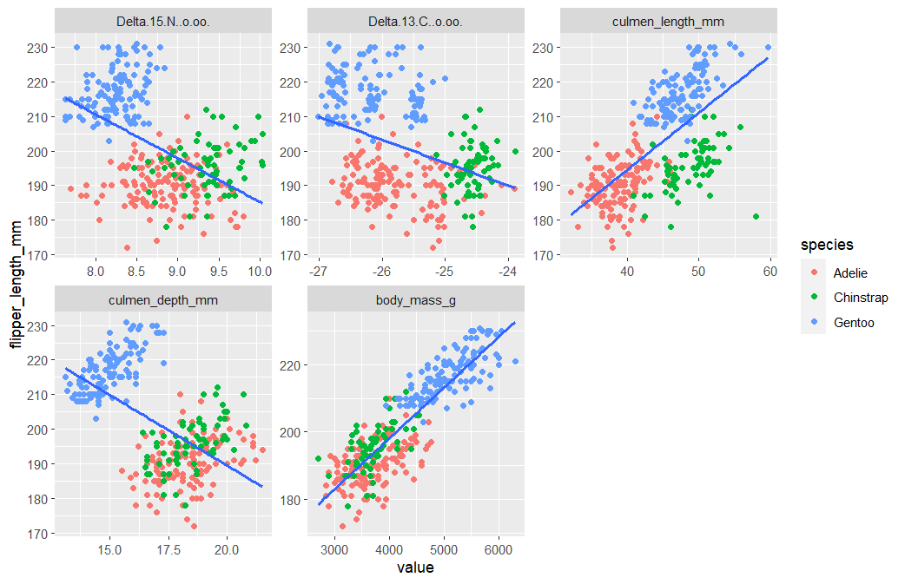
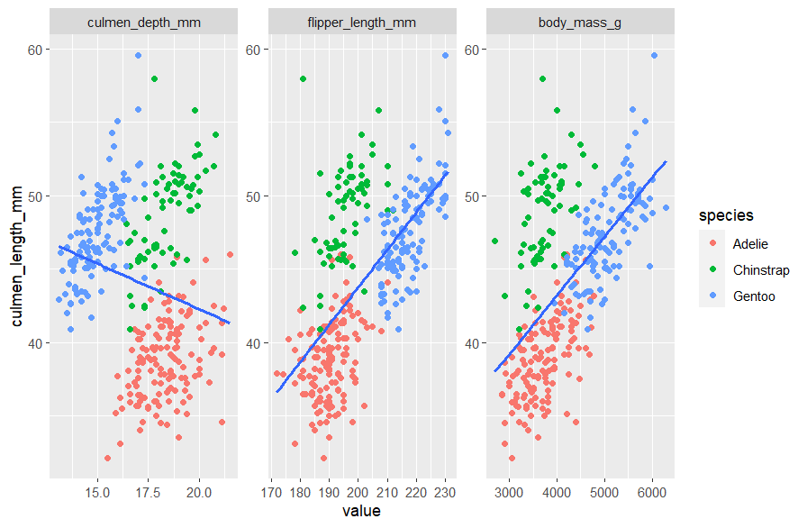
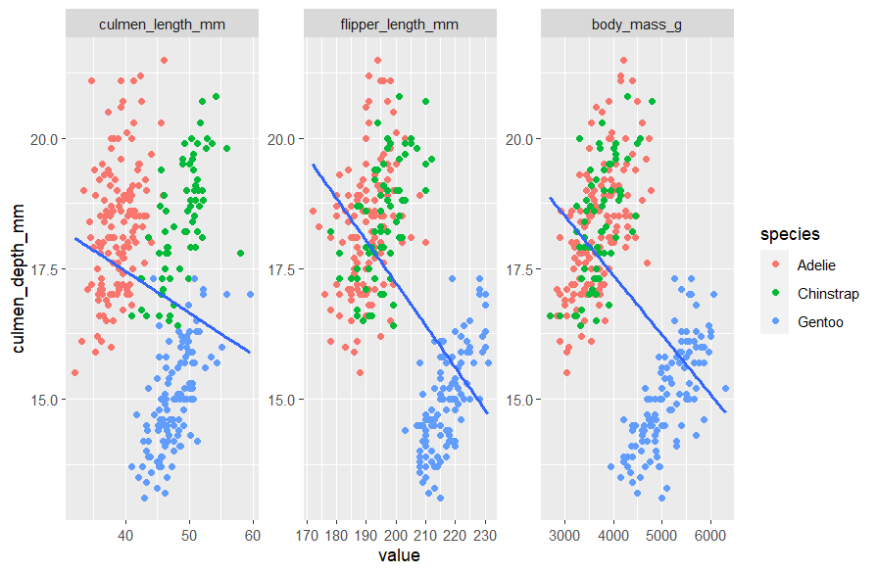
EXPLORATORY DATA ANALYSIS (CONTINUOUS)
Generally has a strong linear relationship

Slide 10
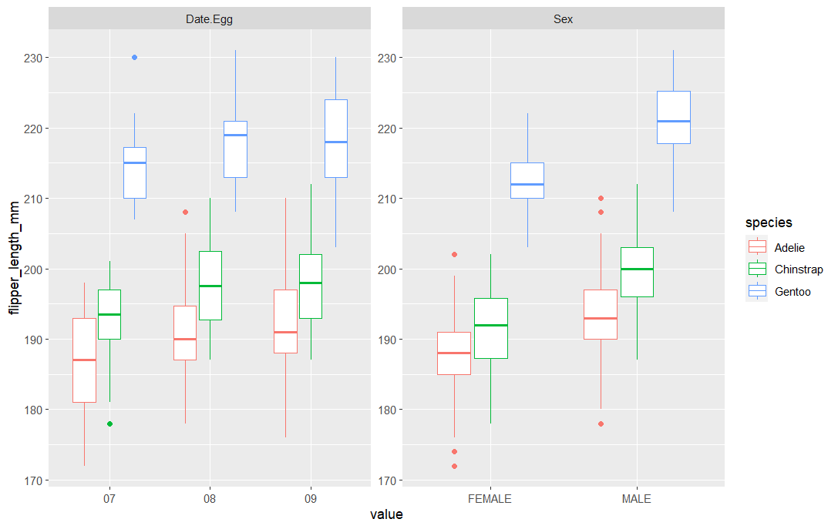
EXPLORATORY DATA ANALYSIS (DISCRETE)
Across discrete and continuous variables correlation between Adelie and Chinstrap
Species has a significant factor

Slide 11
02
MODEL CONSTRUCTION & FITTING

Slide 12
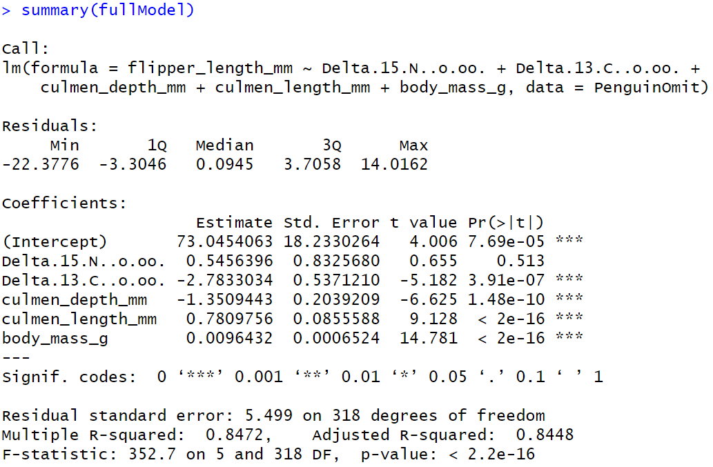
MODEL CONSTRUCTION
Delta 13, Culmen Depth, Culmen Length, and Body mass are influential regressors, with the latter two having the highest influence
Delta 15 is the only variable without a strong influence to Flipper Length
MERCURY
Mercury is the closest planet to the Sun and the smallest one in the Solar System—it’s only a bit larger than the Moon. This planet’s name has nothing to do with the liquid metal, since Mercury was named after the Roman messenger god

Slide 13
VARIANCE INFLATION FACTORS
Variable: | Delta 13 | Culmen Depth | Culmen Length | Body Mass
VIF: | 1.927347 | 1.719255 | 2.348709 | 2.977464
No signs of multicollinearity
No need to remove the remaining variables
Variable: | Delta 13 | Culmen Depth | Culmen Length | Body Mass
VIF: | 1.819519 | 1.425882 | 2.259734 | 2.603961

Slide 14
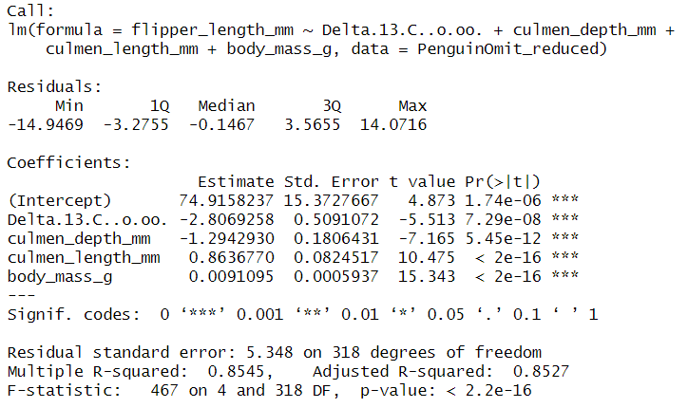
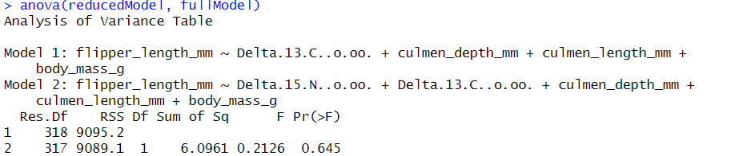
ANOVA COMPARISON
After removing Delta 15 and an outlier point we had we created our reduced model
Adj R^2 = 0.8527
With a P value significantly greater than ɑ = 0.5, our reduced model is better than the full model

Slide 15
03
TRANSFORMATION, RESIDUAL ANALYSIS & INFLUENTIAL POINTS

Slide 16
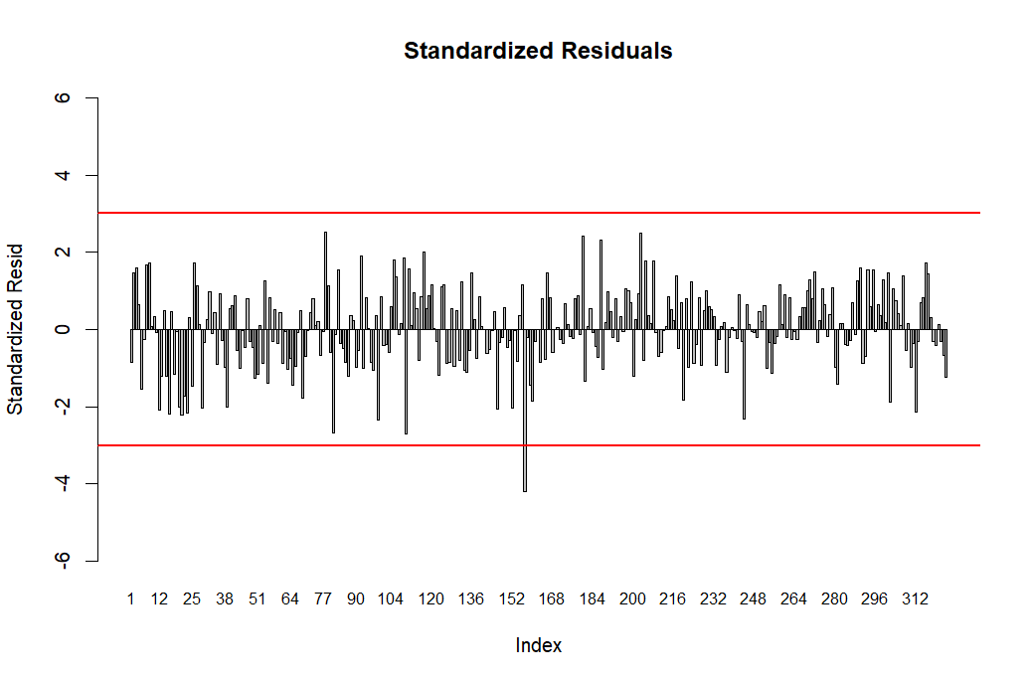

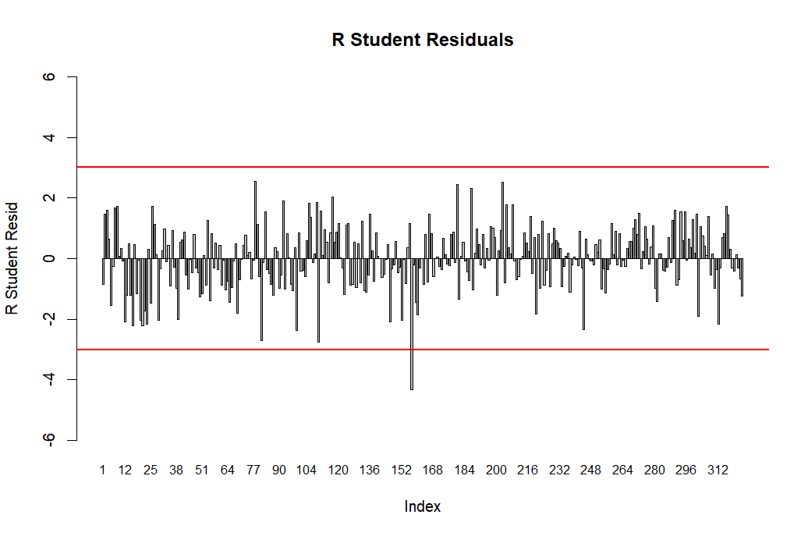
RESIDUAL ANALYSIS - Full Model
JUPITER
SATURN

Slide 17
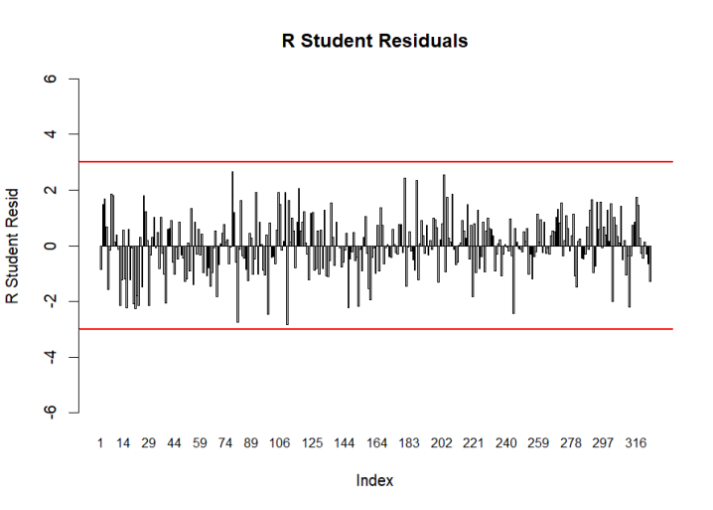
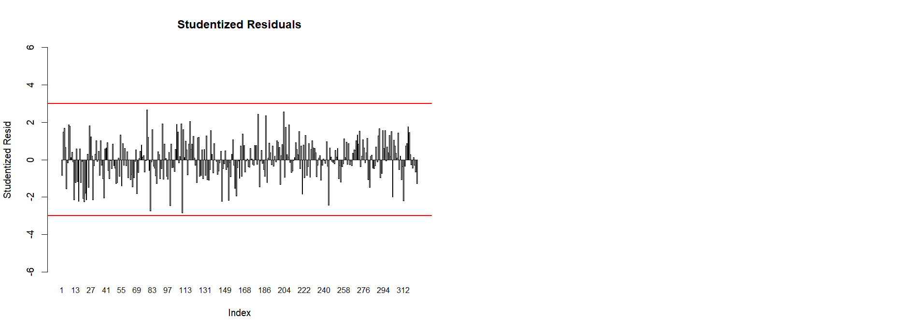

RESIDUAL ANALYSIS - Reduced Model

Slide 18
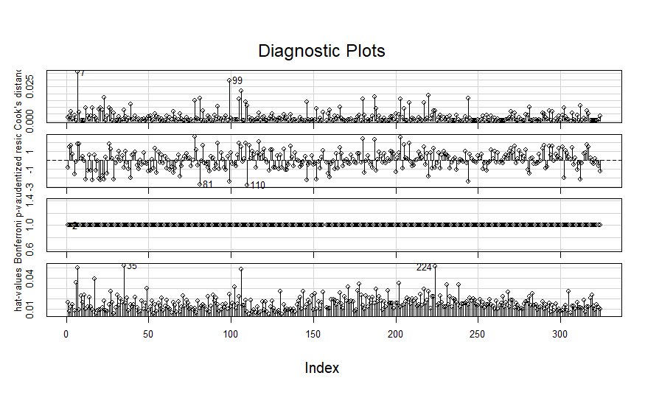
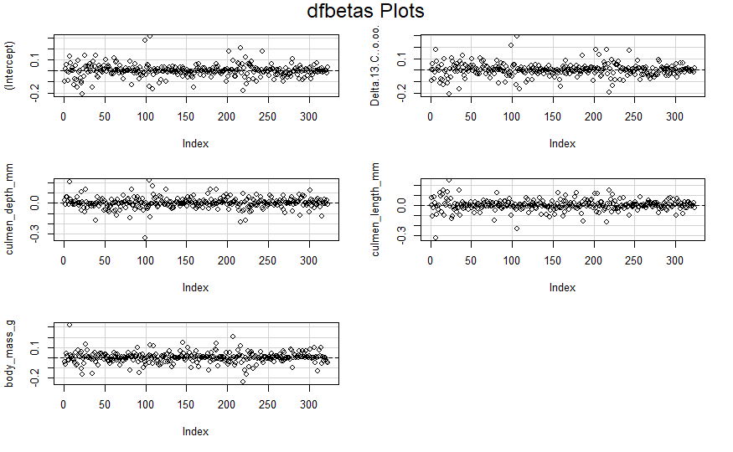
INFLUENTIAL POINTS ANALYSIS
19 influential points, which makes up 5.88% of the dataset
Hat values: 4
DFBETAS: 9
DFFITS: 2
COVRATIO: 17
Influential points:
Observation #7
Observation #99
Observation #106

Slide 19
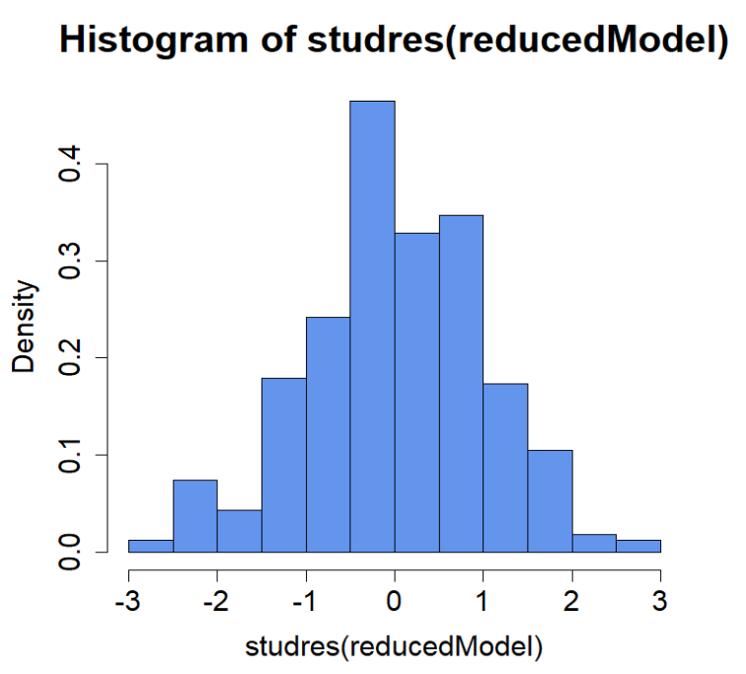
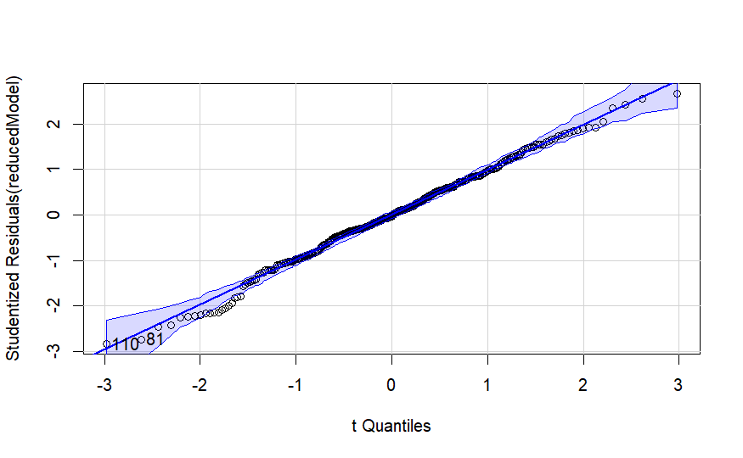
TRANSFORMATION

Slide 20
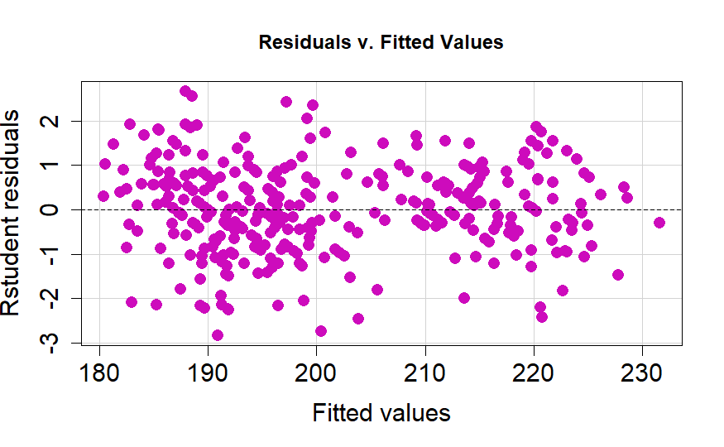
TRANSFORMATION
The fitted values are spread out, but converge around the zero line.

Slide 21
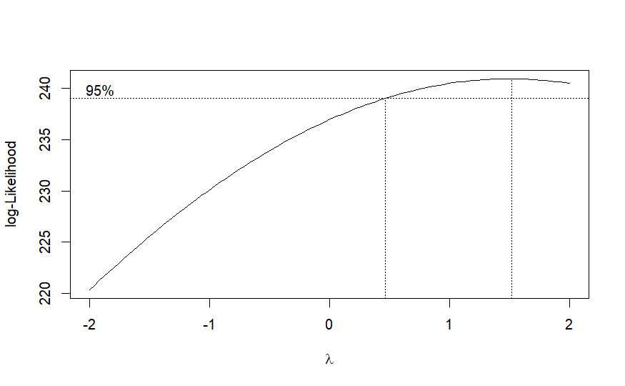
TRANSFORMATION
λ = 1.515152
Since the lambda value of 1 is in the 95% confidence range of the Box-Cox plot, it is deemed unnecessary to perform a transformation on our data.

Slide 22

CONCLUSION
Y = 74.9158237 - 2.8069258 D13_C - 1.2942930 CulD_mm + 0.8636770 CulL_mm + 0.0091095 BodyM_g
Future Goals:
In the future we hope to possibly look at a variety of other species and include a more varying list of characteristics in our regressor variables to provide a more comprehensive analysis

Slide 23
Citations
Palmer Station Antarctica LTER and K. Gorman. 2020. Structural size measurements and isotopic signatures of foraging among adult male and female Adélie penguins (Pygoscelis adeliae) nesting along the Palmer Archipelago near Palmer Station, 2007-2009 ver 5. Environmental Data Initiative. https://doi.org/10.6073/pasta/98b16d7d563f265cb52372c8ca99e60f (Accessed 2023-12-04).
Palmer Station Antarctica LTER and K. Gorman. 2020. Structural size measurements and isotopic signatures of foraging among adult male and female Gentoo penguin (Pygoscelis papua) nesting along the Palmer Archipelago near Palmer Station, 2007-2009 ver 5. Environmental Data Initiative. https://doi.org/10.6073/pasta/7fca67fb28d56ee2ffa3d9370ebda689 (Accessed 2023-12-04).
Palmer Station Antarctica LTER and K. Gorman. 2020. Structural size measurements and isotopic signatures of foraging among adult male and female Chinstrap penguin (Pygoscelis antarctica) nesting along the Palmer Archipelago near Palmer Station, 2007-2009 ver 6. Environmental Data Initiative. https://doi.org/10.6073/pasta/c14dfcfada8ea13a17536e73eb6fbe9e (Accessed 2023-12-04).
Gorman KB, Williams TD, Fraser WR (2014) Ecological Sexual Dimorphism and Environmental Variability within a Community of Antarctic Penguins (Genus Pygoscelis). PLoS ONE 9(3): e90081. doi:10.1371/journal.pone.0090081. https://www.kaggle.com/datasets/parulpandey/palmer-archipelago-antarctica-penguin-data/data
https://allisonhorst.github.io/palmerpenguins/reference/penguins_raw.html

Slide 24
THANKS
Do you have any questions?
Please keep this slide for attribution

